Slide 1
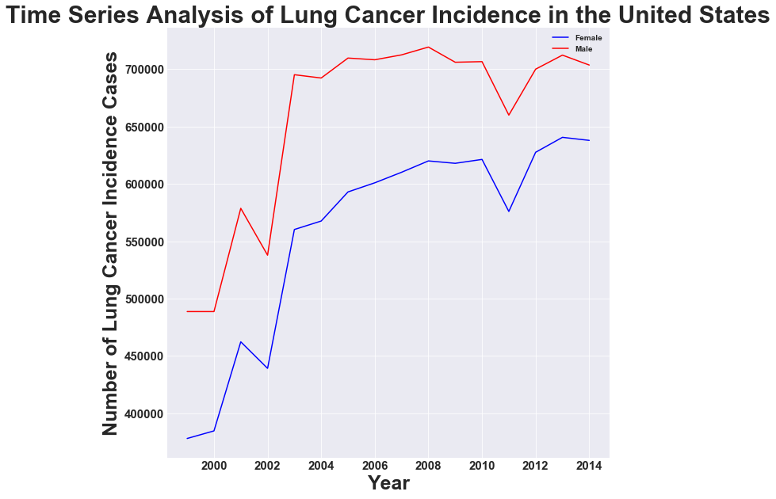
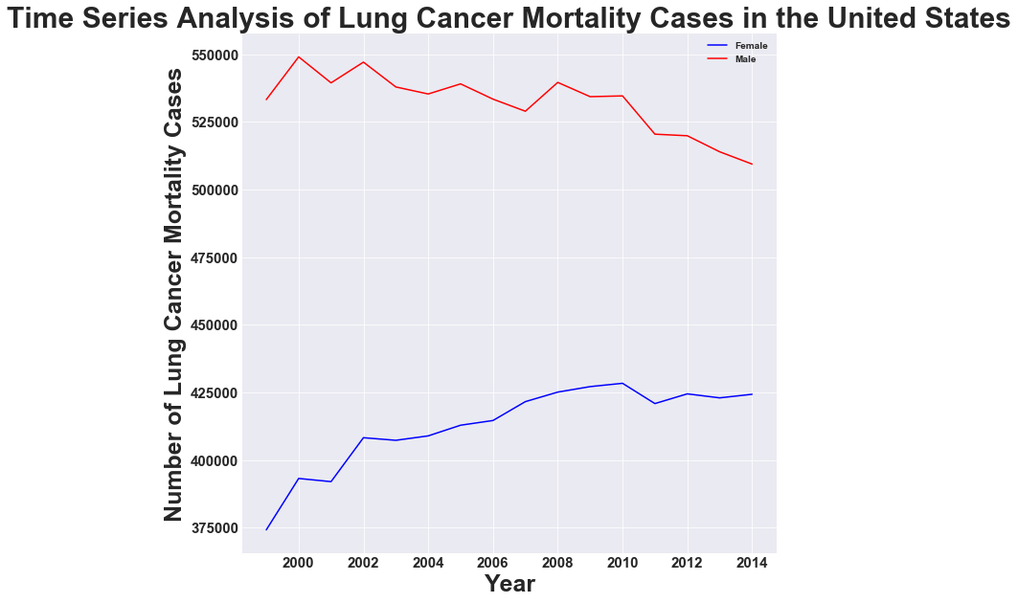
Big Data Analysis of Lung Cancer Characteristics in the United States Shilpa Balan, Vrunda Shah, Nishant Shristiraj California State University-Los Angeles
Big Data in Biomedicine 2018, Stanford University
Introduction
Lung cancer is the most common cancer in the world. It is the leading cause of cancer death in the USA (World Cancer Research Fund, 1997). Big Data has rapidly evolved including in the healthcare industry. Big Data in healthcare is being used to predict and cure diseases and to improve quality of life (Marr, 2015). There are many challenges in the diagnosis of lung cancer. Lung cancer is often silent early in its course. When symptoms occur they are usually non‐specific. Thus, most lung cancer is diagnosed at an advanced stage when treatment is less successful (Jemal and Siegel, 2006). The analysis in this study aims to examine the time trends in lung cancer incidences and mortality, and the sentiment analysis of lung cancer patients.
Research Background
Worldwide, lung cancer kills over one million people each year (World Cancer Research Fund, 1997). In 2006, lung cancer caused over 158,000 deaths—more than colorectal, breast, and prostate cancers combined (American Cancer Society, 2006). Extensive data clearly establish cigarette smoking as the major cause of lung cancer (Blot et al., 1996). From previous research, it is seen that there are more number of youth male smokers than youth female smokers (Balan et al., 2017). Cigarette smoking leads to diseases such as cardiovascular disease, chronic obstructive pulmonary disease and lung cancer (Holbrook et al., 1984). It is estimated that about 90% of male lung cancer deaths and 75%–80% of female lung cancer deaths in the United States each year are caused by smoking (Surgeon General, 1989, Shopland DR, 1995). In this research, Python scripts are written for data analysis.
Research Methodology
In this research, we used the open data set from CDC (2017) on cancer data. The data contains information on incidence and mortality types, the different cancer types including lung cancer details, year and population. We wrote Python scripts to analyze and visualize the data. Python is a highly functional programming language that is used for data analysis, to create GUI’s and websites (Ping Ong et al., 2013). Python has a large collection of open source packages. In addition, we wrote Python scripts to extract data from Twitter for the hashtag #lungcancer and #lung cancer. Data is collected for both the hashtags for the most recent dates from April 1, 2018 to April 20, 2018. Due to its openness, Twitter has generated massive amounts of data.
Analysis
Results
From Figure 1, it is seen that lung cancer incidences in the United States for both females and males have significantly increased from 2002 to 2010 with a significant drop in 2011. From 2012 onward, there has been a rise in the number of lung cancer incidence cases for both males and females in the United States. From the year 2003 to 2010, it is seen that in the United States, the count of lung cancer incidence cases ranges approximately from 680,000 to 705,000 for male, and from 560,000 to 615,000 for females, showing a greater percentage of increase for the females. In the United States, the overall number of lung cancer incidences is more in males than females. From 2013 to 2014, it is seen that there is a slight decrease in the number of lung cancer incidences for both males and females in the United States. Figure 2 shows that in the United States, the number of lung cancer mortality cases is more in males than females. It is seen that there are more number of negative sentiments than positive sentiments for lung cancer patients. For example, struggling and cry were some negative sentiments. Some lung cancer patients had positive sentiments on improvement of health.
Conclusion
In the United States, the number of lung cancer incidence cases and the number of lung cancer mortality cases is more for males than females. There are many challenges in the diagnosis of lung cancer. People with the lowest risk of lung cancer were less likely to have lung cancer detected (NCI, 2018). The high mortality rate for lung cancer is from the failure to achieve early diagnosis. For future research, we plan to explore more tweets related to lung cancer. The tweets will help us to broaden our research on sentiment analysis for lung cancer. For future, we also plan to analyze the percentage of lung cancer cases that are diagnosed at its early stage.
References
American Cancer Society (2006). Statistics for 2006. Accessed October 6, 2017, at: http://www.cancer.org/docroot/stt/stt_0.asp Balan, S., Shristiraj, N., Shah, V., Manjappa, A. (2017). Big Data Analysis of Youth Tobacco Smoking Trends in the United States. 2017 IEEE International Conference on Big Data. Boston, MA. Blot WJ, Fraumeni JF Jr. (1996). Cancers of the lung and pleura. In: Schottenfeld, D, Fraumeni J Jr, editors. Cancer Epidemiology and Prevention. New York (NY): Oxford University Press; p. 637–65. CDC (2017). United States Cancer Statistics. Retrieved on Jan 25, 2018, from https://www.cdc.gov/cancer/npcr/uscs/download_data.htm Holbrook, JH., Grundy, SM., Hennekens, CH., Kannel, WB., Strong, JP. (1984). Cigarette smoking and cardiovascular diseases: A statement for health professionals by a task force appointed by the steering committee of the American Heart Association. Jemal A, Siegel R, Ward E. et al (2006). Cancer statistics. CA Cancer J Clin 200656106–130. Marr (2015). How Big Data is Changing Healthcare. Retrieved on Jan, 20, 2017 from http://www.forbes.com/sites/bernardmarr/2015/04/21/how-big-data-is-changing-healthcare/#11f4a6e832d9 NCI (2018). Lung Cancer Screening Most Beneficial For Those at Highest Risk, Analysis Suggests. Retrieved March, 2018, from https://www.cancer.gov/news-events/cancer-currents-blog/2018/lung-cancer-screening-identifying-who-benefits Ping Ong, S., Richards, W., Jain, A., Hautier, G., Kocher, M., Cholia, S., Gunter, D., Chevrier, V., Persson, K., Ceder, G. (2013). Python Materials Genomics (pymatgen): A robust, open-source python library for materials analysis. Computational Materials Science. pp 314-319. Shopland DR (1995). Tobacco use and its contribution to early cancer mortality with a special emphasis on cigarette smoking. Environ Health Perspect. 103 Suppl 8:131–42. Surgeon General (1989). Reducing the health consequences of smoking: 25 years of progress. Washington (DC). World Cancer Research Fund (1997). American Institute for Cancer Research. Food, nutrition and the prevention of cancer: a global perspective. Washington, DC: American Institute for Cancer Research, 37–145.
Figure 1: Time Series Analysis of Lung Cancer Incidences in the United States
Figure 2: Time Series Analysis of Lung Cancer Mortality Cases in the United States
Sentiment positive signals | Sentiment negative signals
promising | risk
improve | harms
prevent | overwhelming
awareness | cry
care | struggling
 | crippling
 | addiction
Sentiment Analysis for #lungcancer #lung cancer

